Slide 1
Machine Learning Algorithms (IV)
Master´s in Applied Artificial Intelligence
Luís Ferreira
lufer@ipca.pt

Slide 2
Overview
Part I
Artificial Intelligence and Machine Learning
Foundations
Part II
Machine Learning
Part III
Machine Learning Algorithms
Parte IV
Deep Learning & Neural Networks
Parte V
Building a ML Model

Slide 3
Part III
Machine Learning Algorithms
Competencies to be acquired:
Choosing ML Algorithms
Improving models

Slide 4

Part III: MLA
Modelling
Choosing the best estimator/algorithm
  In Sklearn refers Algorithms or Machine Learning Models as “estimators”
  Classification problem - predicting a category (it will rain or not)
  Regression problem – predicting a number (the temperature)
https://scikit-learn.org/stable/tutorial/machine_learning_map/index.html

Slide 5
Part III: MLA
Modell Improvement
Improving a model on data, model or parameters:
  From the data perspective:
    Can the data be improved?
    Could we collect more data (the more data, the better, usually!)
  From the model perspective
    Is there a better model?
    Can the current model be improved? (exploring hyperparameters)
Notes:
141

Slide 6
Part III: MLA
Modell Improvement
Hyperparameters versus Parameters
  Parameters
    correspond to patterns that model found in data
  Hyperparameters
    are model settings that we can try to adjust
Notes:
141

Slide 7
Part III: MLA
Modell Improvement
How to manipulate
  Manually
  Randomly with RandomSearchCV
  Exhaustively with GridSearchCV
Notes:
141

Slide 8
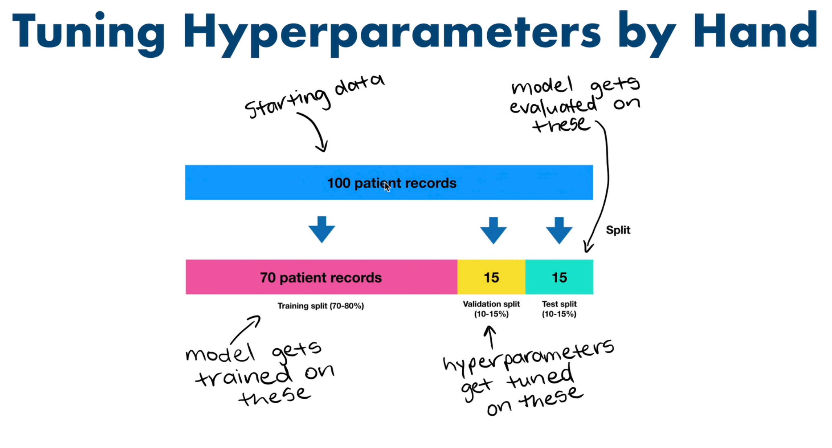
Part III: MLA
Modell Improvement
Train a model on the training data.
(Try to) improve the model's hyperparameters on the validation set.
Evaluate the model on the test set.
Manipulating hyperparameters by hand
  Create a new dataset part (Validation Dataset)
  Hyperparameters are tuned on Validation Set
Notes:
141

Slide 9
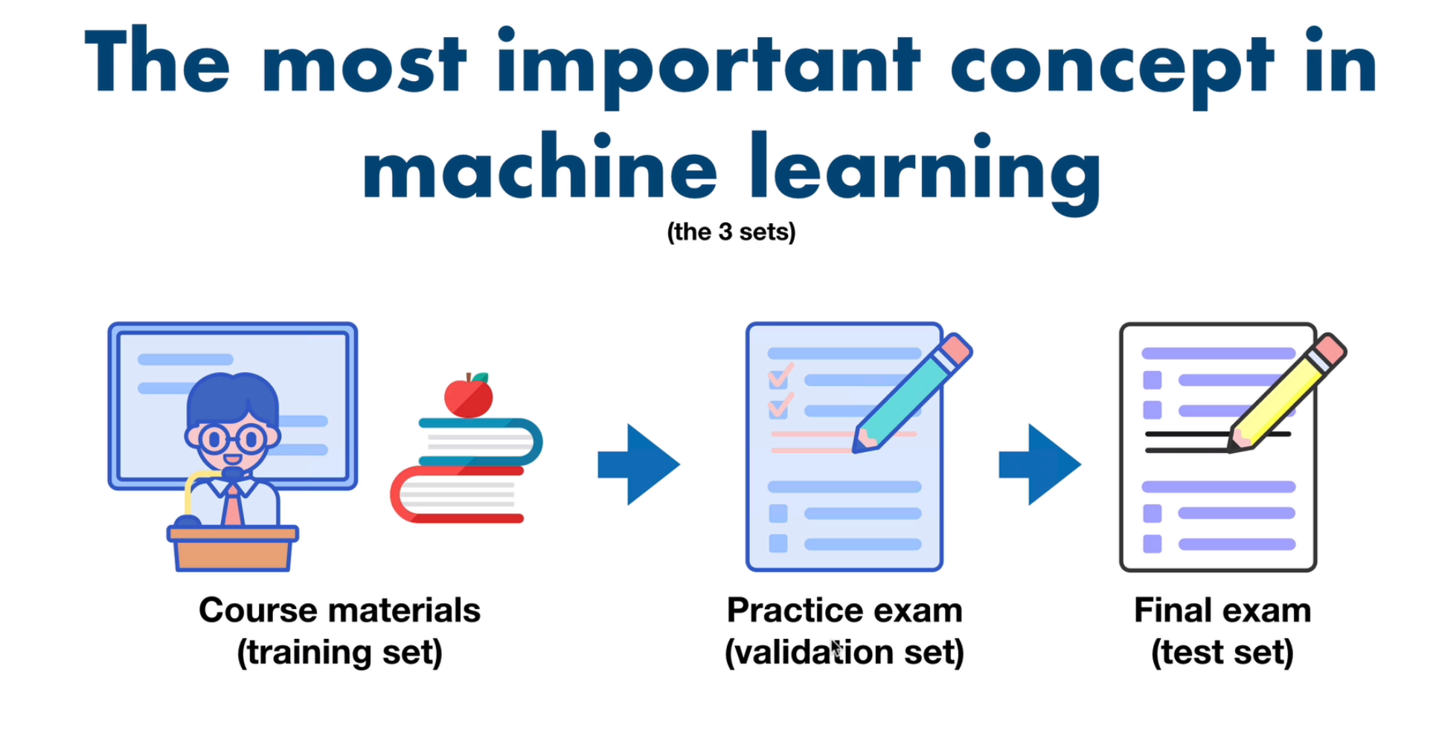
Part III: MLA
Modell Improvement
Manipulating hyperparameters by hand
  Create a new dataset part (Validation Dataset)
  Hyperparameters are tuned on Validation Set
  Model is evaluated on test dataset
Notes:
141

Slide 10
Part III: MLA
Modell Improvement
X
y
y_train
X_test
Y_test
X_train
X_train, X_test, y_train, y_test = train_test_split(X,y,test_size=0.2)
rf = RandomForestClassifier()
rf.fit(X_train,y_train)
y_preds=rf.predict(X_test)
rf.score(X_test,y_test)
…
accuracy_score(y_test,y_preds)
Notes:
141

Slide 11
Part III: MLA
Modell Improvement
X
y
y_train
X_valid
y_valid
X_test
X_train
Y_test
# Training and test split (70% train, 30% test)
X_train, X_test, y_train, y_test = train_test_split(X, y, test_size=0.3)
# Create validation and test split by spliting testing data in half (30% test -> 15% validation, 15% test)
X_valid, X_test, y_valid, y_test = train_test_split(X_test, y_test, test_size=0.5)
clf = RandomForestClassifier()
clf.fit(X_train, y_train)
y_preds = clf.predict(X_valid)
accuracy_score(y_valid,y_preds)
Notes:
141

Slide 12
Part III: MLA
Modell Improvement
Manipulating hyperparameters by hand
  Check existing hyperparameters for the selected model
  Example:
    https://scikit-learn.org/stable/modules/generated/sklearn.ensemble.RandomForestClassifier.html
  Change hyperparameters’ values
  Experiment incrementally
model = RandomForestClassifier(n₁=v₁, n₂=v₂,…,n_{i}=v_{i}) #new instance
model.fit(X_train, y_train) #train
model.score(X_test, y_test) #evaluate
Notes:
141

Slide 13
Part III: MLA
Modell Improvement
Manipulating hyperparameters by hand
  Check existing hyperparameters for the selected model
  Example:
    https://scikit-learn.org/stable/modules/generated/sklearn.ensemble.RandomForestClassifier.html
Change hyperparameters’ values
Experiment incrementally
model = RandomForestClassifier( #new instance
n_estimators=120,
max_depth=10
)
model.fit(X_train, y_train) #train
model.score(X_test, y_test) #evaluate
Notes:
141

Slide 14
Part III: MLA
Modell Improvement
Manipulating hyperparameters by hand
  Check existing hyperparameters for the selected model
  Example:
    https://scikit-learn.org/stable/modules/generated/sklearn.ensemble.RandomForestClassifier.html
Change hyperparameters values
Experiment int incrementally
for i in range(100, 200, 10):
model = RandomForestClassifier(n_estimators=i) #new instance
model.fit(X_train, y_train) #train
model.score(X_test, y_test) #evaluate
Notes:
141

Slide 15
Part III: MLA
Modell Improvement
Manipulating hyperparameters by hand
  Check existing hyperparameters for the selected model
  Example:
    https://scikit-learn.org/stable/modules/generated/sklearn.ensemble.RandomForestClassifier.html
  Change hyperparameters values
  Experiment int incrementally
  Force cross-validation (k-fold cross-validation)
Notes:
141

Slide 16
Part III: MLA
Modell Improvement
Remember: The purpose of cross-validation is model checking, not model building
To build, see about “bootstrap aggregation or bagging”
https://machinelearningmastery.com/train-final-machine-learning-model/
Manipulating hyperparameters by hand
  Check existing hyperparameters for the selected model
  Example:
    https://scikit-learn.org/stable/modules/generated/sklearn.ensemble.RandomForestClassifier.html
Change hyperparameters values
Experiment int incrementally
Force cross-validation
for i in range(100, 200, 10):
model = RandomForestClassifier(n_estimators=i) #new instance
model.fit(X_train, y_train) #train
#model.score(X_test, y_test) #evaluate single
cross_val_mean = np.mean(cross_val_score(model, X, y, cv=5)) #evaluate several
Notes:
Technique called bootstrap aggregation (usually shortened to 'bagging’): use model instances produced in a way similar to cross-validation to build up an ensemble model

Slide 17
Part III: MLA
Modell Improvement
How to manipulate
  Manually (Ok)
  Randomly with RandomSearchCV
  Exhaustively with GridSearchCV
Notes:
141

Slide 18
Part III: MLA
Modell Improvement
Manipulating hyperparameters with RandomSearchCV
  “(…) implements a “fit” and a “score” method. It also implements “score_samples”, “predict”, “predict_proba”, “decision_function”, “transform” and “inverse_transform” if they are implemented in the estimator used(…)”
https://scikit-learn.org/stable/modules/generated/sklearn.model_selection.RandomizedSearchCV.html
Notes:
141

Slide 19
Part III: MLA
Modell Improvement
Manipulating hyperparameters with RandomSearchCV
  Create a dictionary with intended parameters/values
# Hyperparameter grid for RandomizedSearchCV
param_values = { "n_estimators": [10, 100, 200, 500, 1000, 1200], "max_depth": [None, 5, 10, 20, 30],
"max_features": ["sqrt", "log2", None],
"min_samples_split": [2, 4, 6, 8],
"min_samples_leaf": [1, 2, 4, 8]
}
param_values = {"hyperparameter_name": [values_to_randomly_try]}
https://scikit-learn.org/stable/modules/generated/sklearn.model_selection.RandomizedSearchCV.html
Notes:
141

Slide 20
Part III: MLA
Modell Improvement
Manipulating hyperparameters with RandomSearchCV
  Create a dictionary with intended parameters/values
  Configure RandomSearchCV
rfc = RandomizedSearchCV( estimator=rfc,
param_distributions=param_values,
n_iter=10, # how many models to try
cv=5, # 5-fold cross-validation
verbose=2)
Notes:
141

Slide 21
Part III: MLA
Modell Improvement
Manipulating hyperparameters with RandomSearchCV
  Create a dictiornay with intended parameters/values
rfc = RandomizedSearchCV( estimator=rfc,
param_distributions=param_values,
n_iter=10, #how many models you test
cv=5, # 5-fold cross-validation
verbose=2)
# “best_params_” variable has the best hyperparameters found
rfc.best_params_
param_values = {"hyperparameter_name": [values_to_randomly_try]}
After this process, calling `predict()` on `rfc`, will use the best hyperparameters it found.
https://scikit-learn.org/stable/modules/generated/sklearn.model_selection.RandomizedSearchCV.html
rfc_y_preds = rfc.predict(X_test)
Notes:
141

Slide 22
Part III: MLA
Modell Improvement
How to manipulate
  Manually (Ok)
  Randomly with RandomSearchCV (Ok)
  Exhaustively with GridSearchCV
Notes:
141

Slide 23
Part III: MLA
Modell Improvement
not all parameter values are tried out, but rather a fixed number of parameter settings is sampled from the specified distributions. The number of parameter settings that are tried is given by n_iter
Manipulating hyperparameters with GridSearchCV
  “(…) not all parameter values are tried out, but rather a fixed number of parameter settings is sampled from the specified distributions(…)”
https://scikit-learn.org/stable/modules/generated/sklearn.model_selection.GridSearchCV.html
Notes:
141

Slide 24
Part III: MLA
Modell Improvement
not all parameter values are tried out, but rather a fixed number of parameter settings is sampled from the specified distributions. The number of parameter settings that are tried is given by n_iter
Manipulating hyperparameters with GridSearchCV
  The main difference between `GridSearchCV` and `RandomizedSearchCV` is `GridSearchCV` searches across a grid of hyperparamters exhaustively (it will try every combination possible), where as, `RandomizedSearchCV` searches across a grid of hyperparameters randomly (stopping after `n_iter` combinations)
Notes:
141

Slide 25
Part III: MLA
Modell Improvement
Manipulating hyperparameters with GridSearchCV
  Create a simpler dictionary with intended parameters/values only
  Star by using the hyperparameters’ sequence resultant from RandomSearchCV
Notes:
141

Slide 26
Part III: MLA
Modell Improvement
Manipulating hyperparameters with GridSearchCV
  Create a simpler dictionary with intended parameters/values
param_values = {"hyperparameter_name": [values_to_randomly_try]}
grid = { "n_estimators": [200, 1000],
  "max_depth": [30, 40],
"max_features": ["log2"],
"min_samples_split": [2, 4, 6],
"min_samples_leaf": [4]}
https://scikit-learn.org/stable/modules/generated/sklearn.model_selection.RandomizedSearchCV.html
Notes:
141

Slide 27
Part III: MLA
Modell Improvement
rfc.best_params_
{
'n_estimators': 1000,
'min_samples_split': 4,
'min_samples_leaf': 4,
'max_features': 'log2',
'max_depth': 30
}
Manipulating hyperparameters with GridSearchCV
  Create a simpler dictionary with intended parameters/values
# Hyperparameter grid for RandomizedSearchCV
param_values = { "n_estimators": [10, 100, 200, 500, 1000, 1200], "max_depth": [None, 5, 10, 20, 30],
"max_features": ["sqrt", "log2", None],
"min_samples_split": [2, 4, 6, 8],
"min_samples_leaf": [1, 2, 4, 8]
}
param_values = {"hyperparameter_name": [values_to_randomly_try]}
grid = { "n_estimators": [200, 1000],
  "max_depth": [30, 40],
"max_features": ["log2"],
"min_samples_split": [2, 4, 6],
"min_samples_leaf": [4]}
Notes:
141

Slide 28
Part III: MLA
Modell Improvement
Manipulating hyperparameters with GridSearchCV
  Create a simpler dictionary with intended parameters/values
grid = { "n_estimators": [200, 1000],
  "max_depth": [30, 40],
"max_features": ["log2"],
"min_samples_split": [2, 4, 6],
"min_samples_leaf": [4]}
gs_clf = GridSearchCV(estimator=clf,
param_grid=grid2,
cv=5, # 5-fold cross-validation
verbose=2)
gs_clf.best_aparams_
Notes:
141

Slide 29
Part III: MLA
Modell Improvement - Summary
Manipulating hyperparameters
  Tune hyperparameters by hand to get a feel of the data/model.
  Create a large set of hyperparameter distributions and search across them randomly with `RandomizedSearchCV`.
  Find the best hyperparameters from 2 and reduce the search space before searching across a smaller subset exhaustively with `GridSearchCV`.
Notes:
141

Slide 30
Part III: MLA
Modell Improvement - Summary
Attention:
If you want to compare and evaluate the results of model_1 and model_2, they should both be trained on the same data (e.g. X_train and y_train) and their predictions should each be made on the same data, for example:
model_1.fit(X_train, y_train)
model_1_preds = model_1.predict(X_test)
model_2.fit(X_train, y_train)
model_2_preds = model_2.predict(X_test)
Manipulating hyperparameters
  Tune hyperparameters by hand to get a feel of the data/model.
  Create a large set of hyperparameter distributions and search across them randomly with `RandomizedSearchCV`.
  Find the best hyperparameters from 2 and reduce the search space before searching across a smaller subset exhaustively with `GridSearchCV`.
Notes:
141

Slide 31
Progress
Part I
Artificial Intelligence and Machine Learning
Foundations
Part II
Machine Learning
Part III
Machine Learning Algorithms (I)
Part IV
Machine Learning Algorithms (II)
Part V
Deep Learning & Neural Networks

Slide 32
References
Machine Learning. Tom M. Mitchel, McGraw-Hill, 1997
Machine Learning for Everyone
  https://vas3k.com/blog/machine_learning/
Machine Learning Tutorial
  https://www.simplilearn.com/tutorials/machine-learning-tutorial/machine-learning-steps
What is machine learning and how does it work? In-depth guide
  https://www.techtarget.com/searchenterpriseai/definition/machine-learning-ML

Slide 33
Appendices

